Slide 1

Introduction to Probabilistic Machine Learning
Ralf Herbrich, Rainer Schlosser
History & Probability

Slide 2


Egal was ist, du kannst uns anrufen!
Wir führen unsere Gespräche wertschätzend und unvoreingenommen.
Du bleibst dabei anonym.
dienstags, mittwochs, donnerstags und sonntags
von 21 bis 24 Uhr
unter 0331 977 1834 oder im Chat
Weitere Infos:
https://nightline-potsdam.de

Slide 3
Course Setup
Goal: Stimulate interest in method development for machine learning algorithms
We will pick the pace that helps you to get excited; please interrupt and ask questions!
Format: We have one topic per week with a lecture and tutorial
Lecture: Monday, 11:00am – 12:30pm (L-E.03)
Tutorial: Tuesday: 3:15pm – 4:45pm (L-E.03)
Assignment: Five assignments to solve them (groups of two). They account for 40% of all points (8 points each)
Handed out every other week on Monday (starting 3rd week, April 20)
Each assignment has a theory and a practice part
Tutorial: Supporting the material of the lecture and the assignments
In the tutorial, Rainer and Johann will solve similar exercises to the assignments with you
They will answer questions you have with the actual assignments
Exam (60 points): Counts for 60% of all points; 120 minutes long (August 13)

Slide 4
Course Material
Books: All our material and communication will happen over Moodle
Bishop, C. Pattern Recognition and Machine Learning. Springer. 2006.
MacKay, D. Information Theory, Inference, and Learning Algorithms. CUP. 2003
Moodle: Share our lecture slides, tutorials, solutions
Location: https://moodle.hpi.de/course/view.php?id=1109
Announcements: https://moodle.hpi.de/mod/forum/view.php?id=37623
GitHub Repository: Supporting material as well as code samples
Location: https://github.com/HPI-Artificial-Intelligence-Teaching/pml-sose2026
If you find mistakes, please submit issues and pull requests
GitHub Classrooms: Used for all our assignments
If you do not have a GitHub account, please create one now
Find a team member as assignments are solved in groups of two
More details tomorrow in the first tutorial

Slide 5
Course Structure
History & Probability Theory (Unit 1)
Inference & Decision Theory (Unit 2)
Graphical Models: Independence (Unit 3)
Graphical Models: Exact Inference (Unit 4)
Graphical Models: Approximate Inference (Unit 5)
Bayesian Ranking (Unit 6)
Linear Basis Function Models (Unit 7)
Bayesian Regression (Unit 8)
Bayesian Classification (Unit 9)
Non-Bayesian Classification (Unit 10)
Gaussian Processes (Unit 11)
Information Theory (Unit 12)
Real-World Applications of Probabilistic Machine Learning (Unit 13)

Slide 6

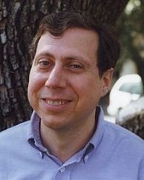


Julia
2012 developed by Jeff Bezanson, Alan Edelman, Stefan Karpinski and Viral B. Shah at MIT
Used for numerical and scientific computing with high performance
Execution speed is similar to C and FORTRAN
Hierarchical and parameterized type system as well as method overloading („multiple dispatching“) as central concepts
Native calls from C-(compiled) code possible (without wrappers)
Unicode is efficiently supported (e.g., UTF-8)
Alongside C, C++ and FORTRAN, the only programming language that has entered the “PetaFlop Club“
Jeff Bezanson (1981– )
Alan Edelman (1963 – )
Stefan Karpinski (1981– )
Viral Shah

Slide 7
Overview
History of Machine Learning
Probability in Machine Learning
Probability Theory
Probability Distributions

Slide 8
Overview
History of Machine Learning
Probability in Machine Learning
Probability Theory
Probability Distributions

Slide 9
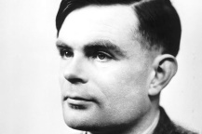
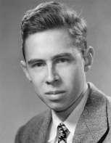
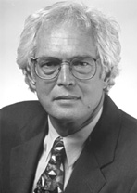
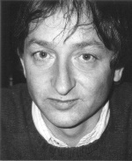



History of Machine Learning
1995: Support Vector Machines
2012: Deep Neural Networks
1967: Nearest Neighbors
1986: Neural Networks
2000: Graphical Models
1950: Turing Test
1957: Perceptrons
Alan Turing
Vladimir Vapnik
Michael Jordan
Frank Rosenblatt
Geoffrey Hinton
Thomas Cover
Yann LeCun, Geoffrey Hinton, Yoshua Bengio

Slide 10
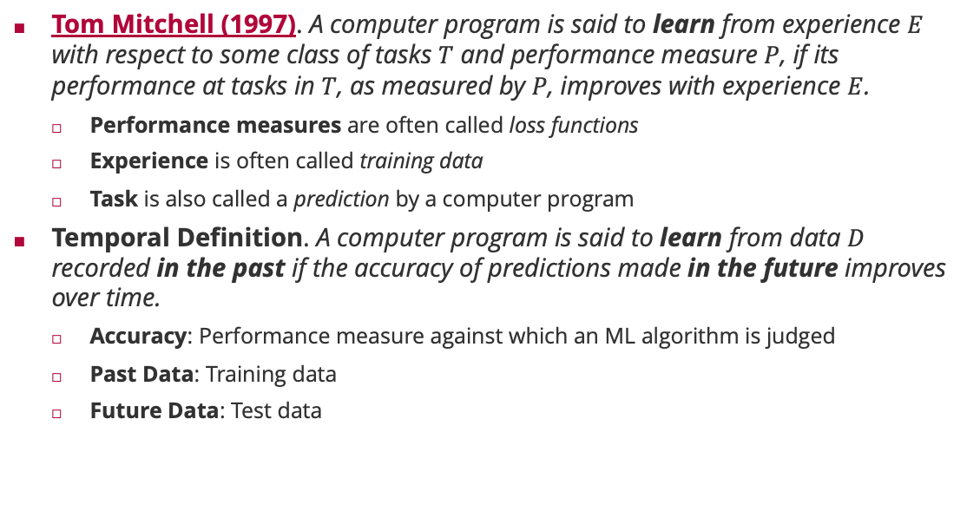
Machine Learning: Definition
Tom Mitchell (1997). A computer program is said to learn from experience $E$ with respect to some class of tasks $T$ and performance measure $P$, if its performance at tasks in $T$, as measured by $P$, improves with experience $E$.
Performance measures are often called loss functions
Experience is often called training data
Task is also called a prediction by a computer program
Temporal Definition. A computer program is said to learn from data $D$ recorded in the past if the accuracy of predictions made in the future improves over time.
Accuracy: Performance measure against which an ML algorithm is judged
Past Data: Training data
Future Data: Test data

Slide 11
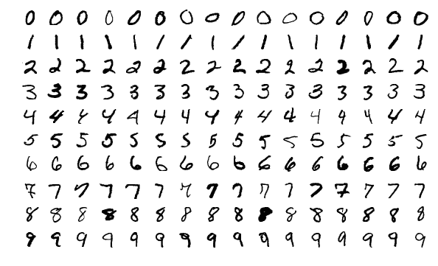
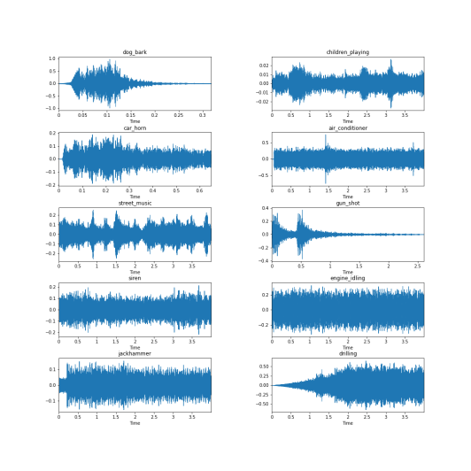
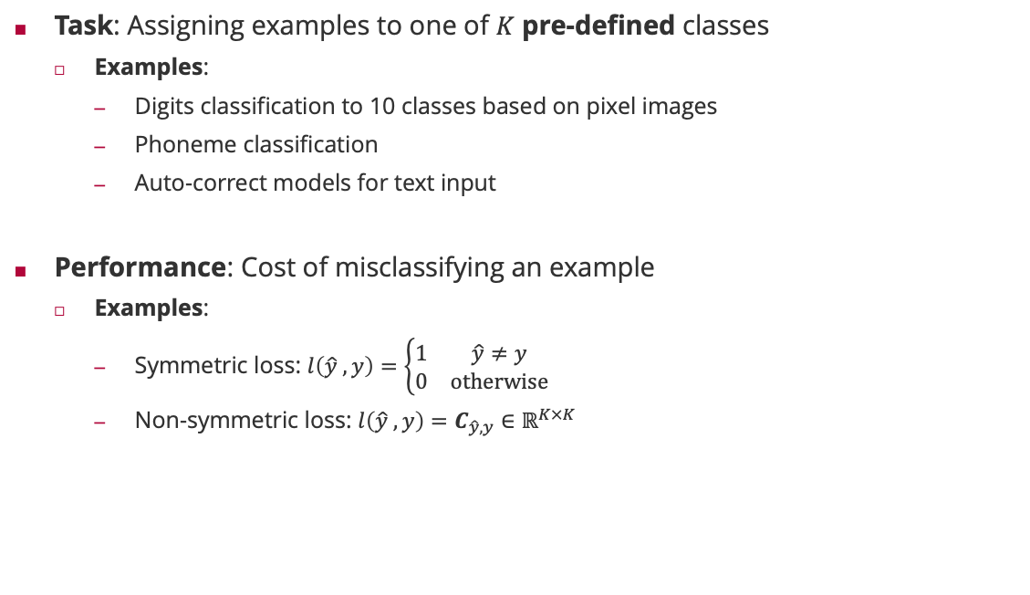
Machine Learning: Classification
Task: Assigning examples to one of $K$ pre-defined classes
Examples:
Digits classification to 10 classes based on pixel images
Phoneme classification
Auto-correct models for text input
Performance: Cost of misclassifying an example
Examples:
Symmetric loss: $l\left(\hat{y} ,y\right)=\left\{\begin{matrix}1 & \hat{y}≠y \\ 0 & otherwise\end{matrix}\right.$
Non-symmetric loss: $l\left(\hat{y} ,y\right)=C_{\hat{y},y}∈ℝ^{K×K}$

Slide 12
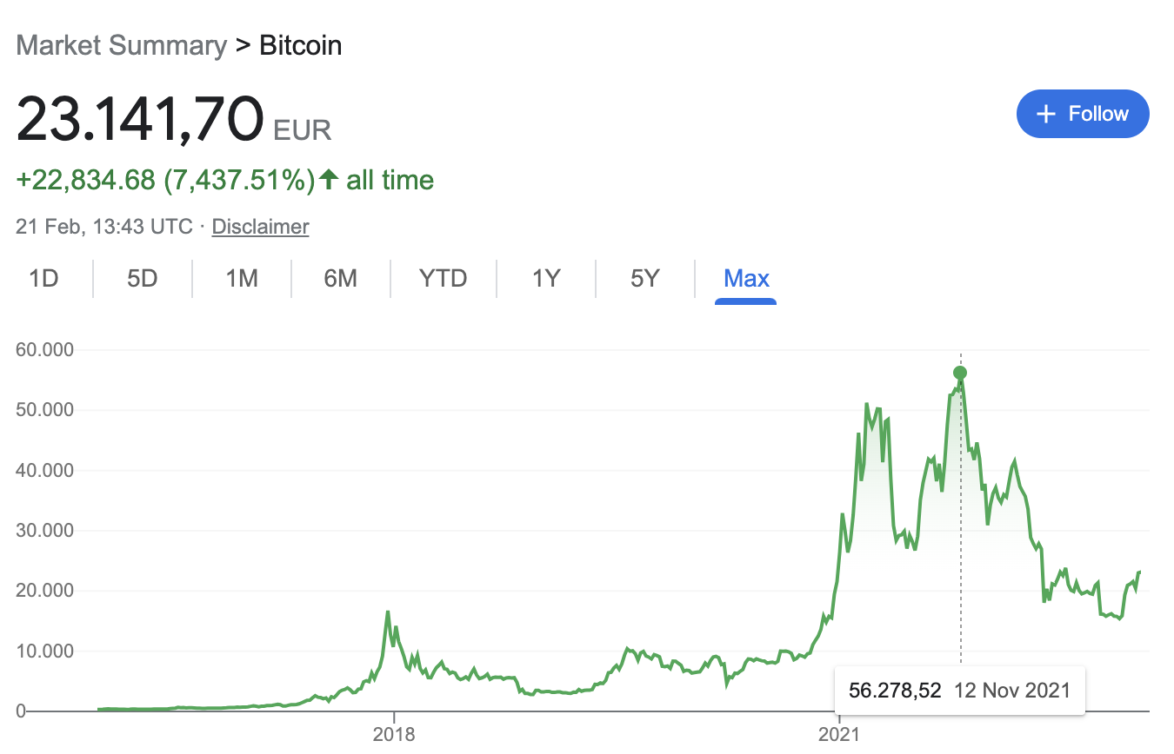
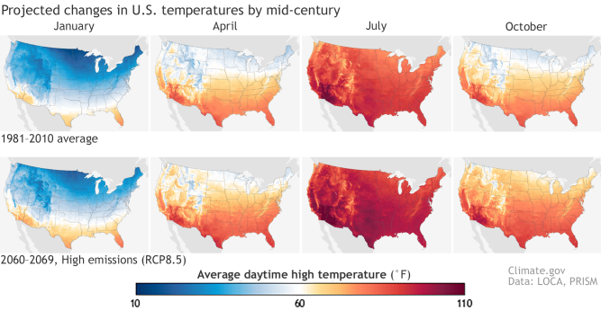
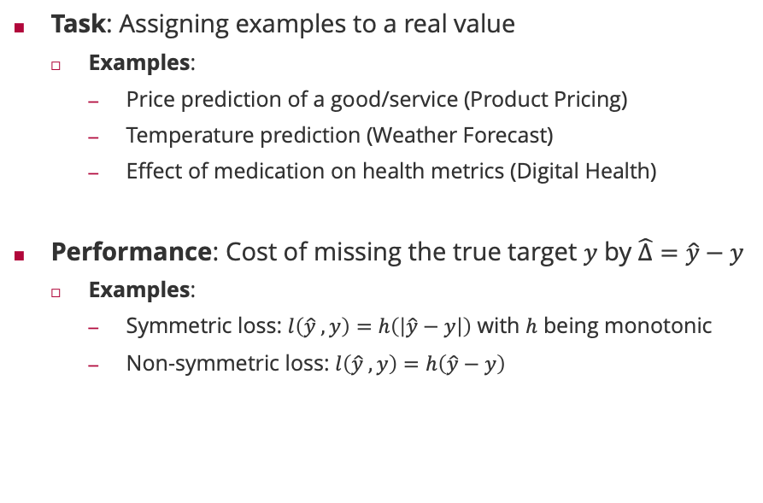
Machine Learning: Regression
Task: Assigning examples to a real value
Examples:
Price prediction of a good/service (Product Pricing)
Temperature prediction (Weather Forecast)
Effect of medication on health metrics (Digital Health)
Performance: Cost of missing the true target $y$ by $\hat{Δ}=\hat{y}−y$
Examples:
Symmetric loss: $l\left(\hat{y} ,y\right)=h\left(\left|\hat{y}−y\right|\right)$ with $h$ being monotonic
Non-symmetric loss: $l\left(\hat{y} ,y\right)=h\left(\hat{y}−y\right)$

Slide 13
Overview
History of Machine Learning
Probability in Machine Learning
Probability Theory
Probability Distributions

Slide 14
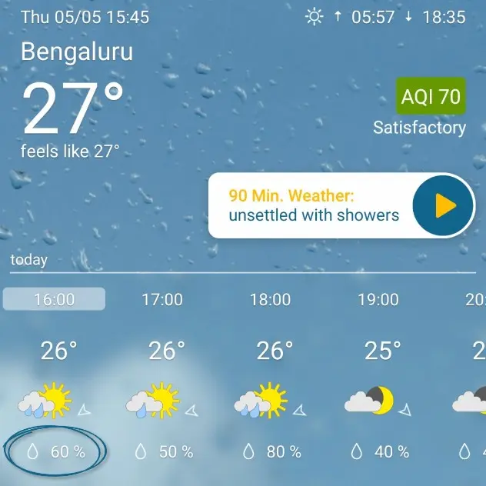
What is Probability?
Weather forecast: A meteorologist says
„Tomorrow, it is going to rain in Bangalore with 60%“
Two interpretations:
The meteorologist has analyzed all regions which have similar environmental conditions than Bangalore today. His (objective) estimate based on past data is that the procedure which predicts rain tomorrow is correct 60% of the time.
The meteorologist believes that it is more likely that it rains tomorrow in Bangalore (than it is to not rain tomorrow). 60% is the quantification of the (subjective) belief of the meteorologist.

Slide 15
Frequentist vs. Subjectivist Interpretation
Frequentist Interpretation
Probability is a property of the event (“it rains tomorrow in Bangalore”)
Is operationalized by repeated experiments
Typically used by scientists and engineers
Subjective Interpretation
Probability is an expression of belief of the person that makes a statement
Is subjective and people-dependent: Two people with identical data can come to different probabilities
Typically used by philosophers and economists
Probability is not a physical measure but a thought model for randomness!
The mathematical rules for probability are identical for both interpretations!

Slide 16
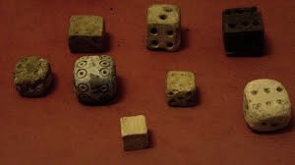
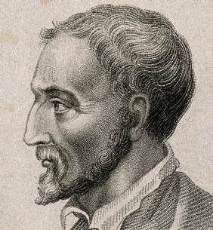
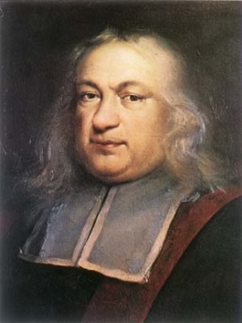
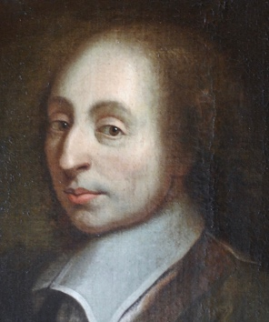
History of Probability
BC:
Chance games were highly popular in ancient Greece & Rome
No mathematical analysis of chance (missing algebraic framework)
16th century:
Girolamo Cardano published first book on methods to calculate the probability of card games and game of dice
17th century:
Pierre de Fermat und Blaise Pascal exchange important questions about probability and motivate the first scientific studies of probability
Gerolamo Cardano (1501 – 1575)
Pierre de Fermat (1607 – 1665)
Blaise Pascal (1623 – 1662)

Slide 17
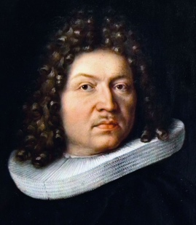
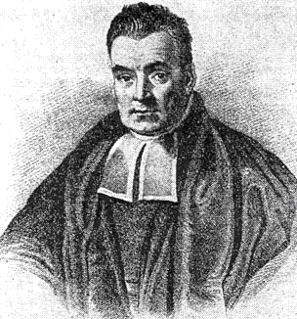
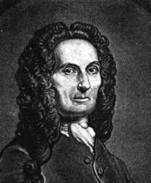
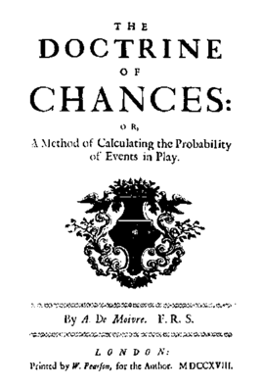
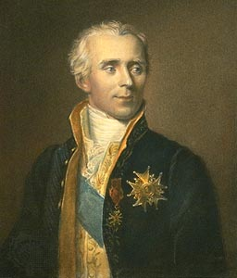
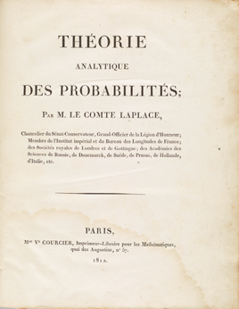
History of Probability (ctd)
18th century:
Jacob Bernoulli investigates random coin tosses and proves the Law of Large Numbers
Thomas Bayes investigates conditional probabilities and formulates Bayes’ rule (published post-hum)
Abraham de Moivre introduces the normal distribution as the limit distribution of an infinite sum of Bernoulli random variables (weak form of central limit theorem)
19th century:
Carl Friedrich Gauss introduces the least-square method and proves that the distribution of independent random variables converges to a normal distribution
Pierre-Simon Laplace publishes Théorie analytique des probabilités where he united probability theory and statistics and introduces hypothesis tests
Jacob Bernoulli (1655 – 1705)
Thomas Bayes (1701 – 1761)
Abraham de Moivre (1667 – 1754)
Pierre-Simon Laplace (1749 – 1827)

Slide 18
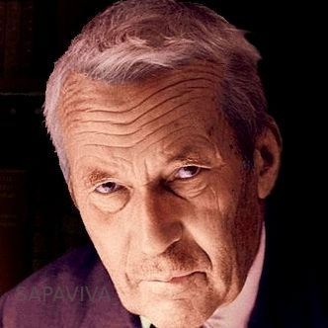

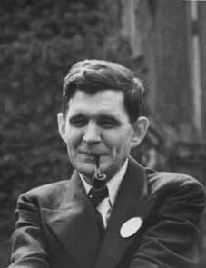
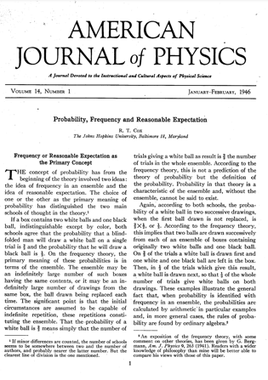


History of Probability (ctd)
20th century:
Andrey Kolmogorov introduces three axioms that imply the rules of probability theory for relative frequencies (frequentist interpretation)
Richard Threlkeld Cox introduces three (other) axioms that imply the rules of probability theory for degrees of belief (subjectivist interpretation)
21st century:
1974: Vladimir Vapnik introduces probability theory as the foundation of the theory of machine learning
1980: Judea Pearl and Phil Dawid introduce graphical models that allow to operationalize probability theory for complex and causal processes
2000: Probability theory and statistics enter every aspect of modern science and artificial intelligence
Andrey Kolmogorov (1903 – 1987)
Richard Threlkeld Cox (1898 – 1991)
Vladimir Vapnik (1936 – )
Judea Pearl (1936– )
Philip Dawid (1946– )

Slide 19
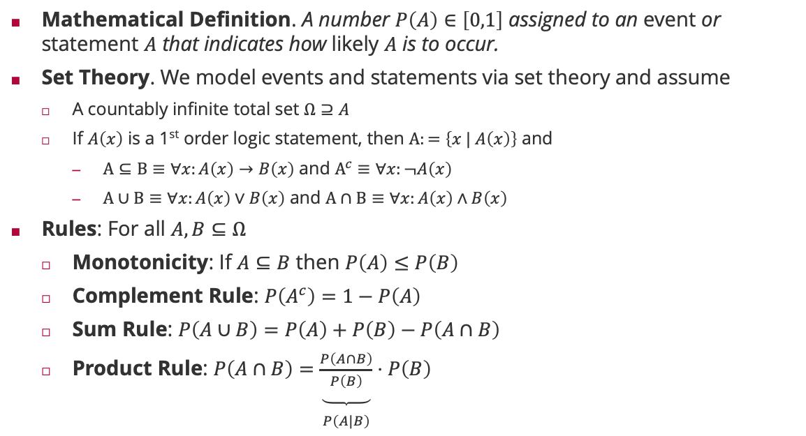
Rules of Probability
Mathematical Definition. A number $P\left(A\right)∈\left[0,1\right]$ assigned to an event or statement $A$ that indicates how likely $A$ is to occur.
Set Theory. We model events and statements via set theory and assume
A countably infinite total set $Ω⊇A$
If $A\left(x\right)$ is a 1st order logic statement, then $Α:=\left\{x | A\left(x\right)\right\}$ and
$Α⊆Β≡∀x:A\left(x\right)→B\left(x\right)$ and $Α^{c}≡∀x:¬A\left(x\right)$
$Α∪Β≡∀x:A\left(x\right)∨B\left(x\right)$ and $Α∩Β≡∀x:A\left(x\right)∧B\left(x\right)$
Rules: For all $A,B⊆Ω$
Monotonicity: If $A⊆B$ then $P\left(A\right)≤P\left(B\right)$
Complement Rule: $P\left(A^{c}\right)=1−P\left(A\right)$
Sum Rule: $P\left(A∪B\right)=P\left(A\right)+P\left(B\right)−P\left(A∩B\right)$
Product Rule: $P\left(A∩B\right)=\underset{\begin{aligned} \\ P\left(A|B\right)\end{aligned}}{\underbrace{\frac{P\left(A∩B\right)}{P\left(B\right)}}}⋅P\left(B\right)$

Slide 20

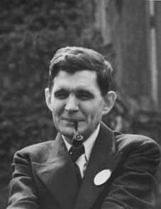
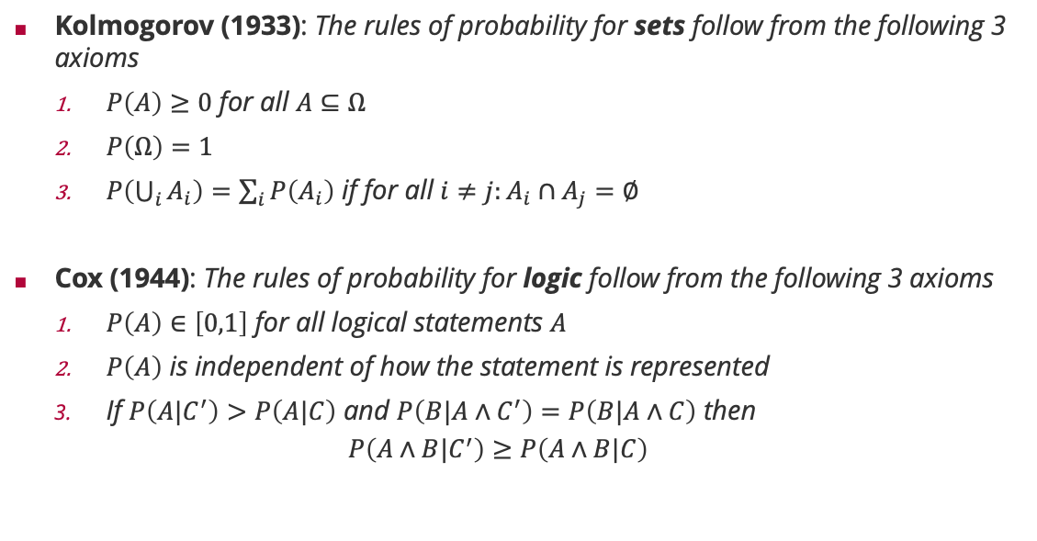
Frequentist vs. Subjective Probabilities
Kolmogorov (1933): The rules of probability for sets follow from the following 3 axioms
$P\left(A\right)≥0$ for all $A⊆Ω$
$P\left(Ω\right)=1$
$P\left(\bigcup_{i}{A_{i}}\right)=\sum_{i}{P\left(A_{i}\right)}$ if for all $i≠j:A_{i}∩A_{j}=∅$
Cox (1944): The rules of probability for logic follow from the following 3 axioms
$P\left(A\right)∈\left[0,1\right]$ for all logical statements $A$
$P\left(A\right)$ is independent of how the statement is represented
If $P\left(A|C^{′}\right)>P\left(A|C\right)$ and $P\left(B|A∧C^{′}\right)=P\left(B|A∧C\right)$ then
$$P\left(A∧B|C^{′}\right)≥P\left(A∧B|C\right)$$
Andrey Kolmogorov (1903 – 1987)
Richard Threlkeld Cox (1898 – 1991)

Slide 21
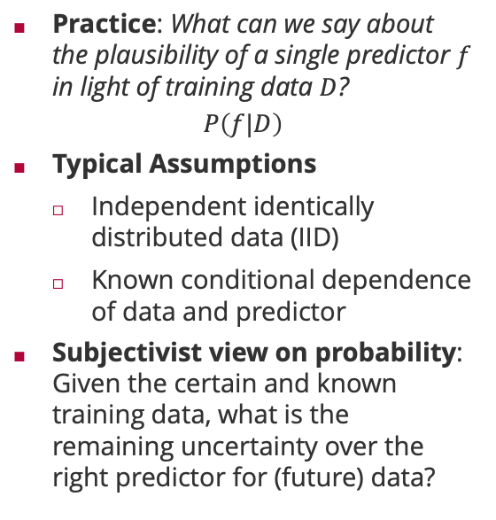
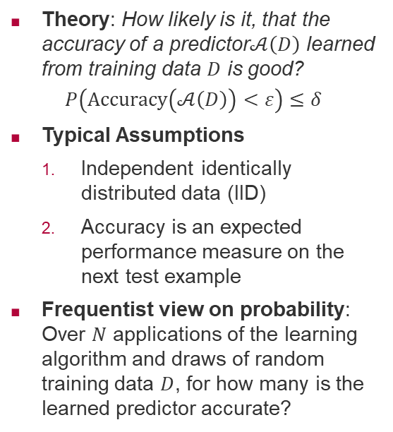
The Role of Probability in Machine Learning
Theory: How likely is it, that the accuracy of a predictor$𝒜\left(D\right)$ learned from training data $D$ is good?
$$P\left(Accuracy\left(𝒜\left(D\right)\right)<ε\right)≤δ$$
Typical Assumptions
Independent identically distributed data (IID)
Accuracy is an expected performance measure on the next test example
Frequentist view on probability: Over $N$ applications of the learning algorithm and draws of random training data $D$, for how many is the learned predictor accurate?
Practice: What can we say about the plausibility of a single predictor $f$ in light of training data $D$?
$$P\left(f|D\right)$$
Typical Assumptions
Independent identically distributed data (IID)
Known conditional dependence of data and predictor
Subjectivist view on probability: Given the certain and known training data, what is the remaining uncertainty over the right predictor for (future) data?

Slide 22
Overview
History of Machine Learning
Probability in Machine Learning
Probability Theory
Probability Distributions

Slide 23


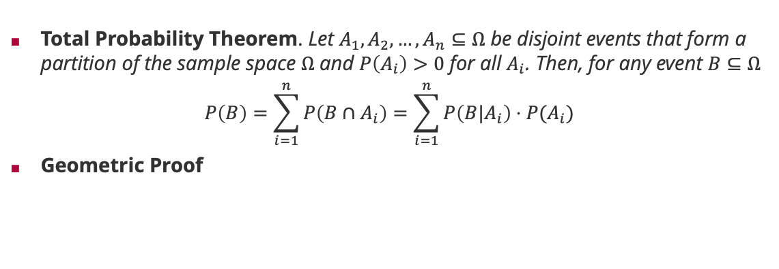








Probability Theory: Law of Total Probability
Total Probability Theorem. Let $A_{1},A_{2},…,A_{n}⊆Ω$ be disjoint events that form a partition of the sample space $Ω$ and $P\left(A_{i}\right)>0$ for all $A_{i}$. Then, for any event $B⊆Ω$
$$P\left(B\right)=\sum_{i=1}^{n}{P\left(B∩A_{i}\right)}=\sum_{i=1}^{n}{P\left(B|A_{i}\right)⋅P(A_{i})}$$
Geometric Proof
$$A_{1}$$
$$A_{2}$$
$$P(B∩A_{1})$$
$$B$$
$$P(B∩A_{2})$$
$$P(B∩A_{4})$$
$$P(B∩A_{3})$$
$$A_{4}$$
$$A_{3}$$
$$Ω$$
Notes:
Central concept for probabilistic machine learning when summing out latent variables that “cause” the data!

Slide 24
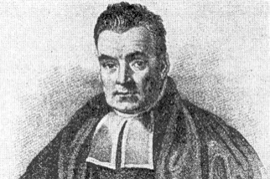
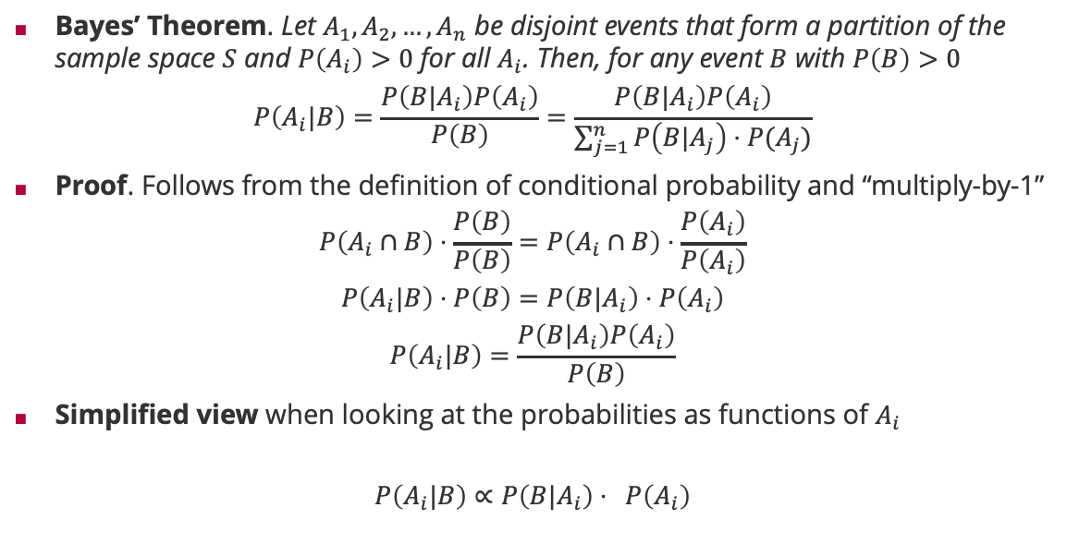

Probability Theory: Bayes Rule
Bayes’ Theorem. Let $A_{1},A_{2},…,A_{n}$ be disjoint events that form a partition of the sample space $S$ and $P\left(A_{i}\right)>0$ for all $A_{i}$. Then, for any event $B$ with $P\left(B\right)>0$
$$P\left(A_{i}|B\right)=\frac{P\left(B|A_{i}\right)P\left(A_{i}\right)}{P\left(B\right)}=\frac{P\left(B|A_{i}\right)P\left(A_{i}\right)}{\sum_{j=1}^{n}{P\left(B|A_{j}\right)⋅P(A_{j})}}$$
Proof. Follows from the definition of conditional probability and “multiply-by-1”
$$P\left(A_{i}∩B\right)⋅\frac{P\left(B\right)}{P\left(B\right)}=P\left(A_{i}∩B\right)⋅\frac{P\left(A_{i}\right)}{P\left(A_{i}\right)}$$
$$P\left(A_{i}|B\right)⋅P\left(B\right)=P\left(B|A_{i}\right)⋅P\left(A_{i}\right)$$
$$P\left(A_{i}|B\right)=\frac{P\left(B|A_{i}\right)P\left(A_{i}\right)}{P\left(B\right)}$$
Simplified view when looking at the probabilities as functions of $A_{i}$
$$P\left(A_{i}|B\right)∝P\left(B|A_{i}\right)⋅ P\left(A_{i}\right)$$
law of total probability
(Rev) Thomas Bayes (1701 – 1761)
=1 (by definition $P\left(A_{i}\right)>0$ and $P\left(B\right)>0$)
by definition of conditional probability
posterior
likelihood
prior
Notes:
Central concept for probabilistic machine learning when $A_{i}$ is the event “predictor $f_{i}$ is the predictor of the dataset” and $B$ is the event “data set $D$ is observed”.

Slide 25
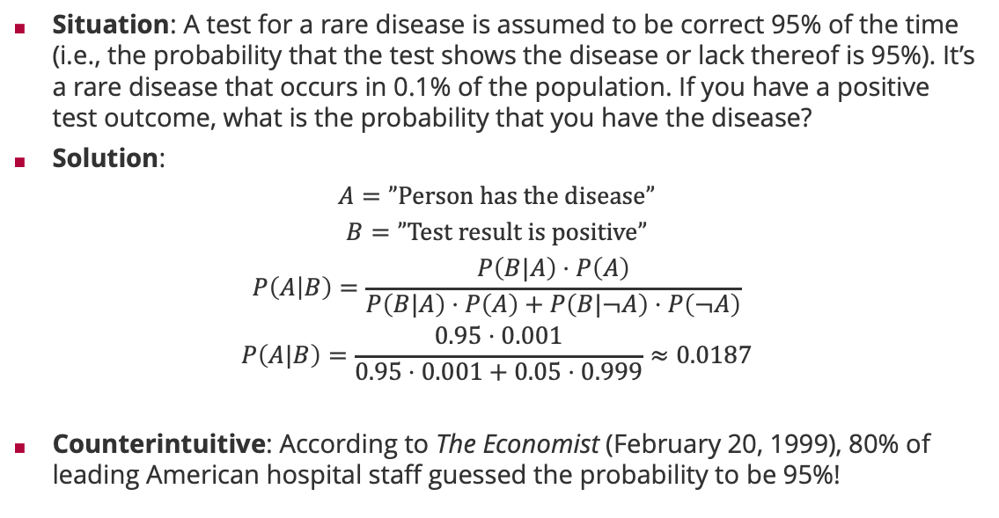
Bayes Rule: False-Positive Puzzle
Situation: A test for a rare disease is assumed to be correct 95% of the time (i.e., the probability that the test shows the disease or lack thereof is 95%). It’s a rare disease that occurs in 0.1% of the population. If you have a positive test outcome, what is the probability that you have the disease?
Solution:
$$A=”Person has the disease”$$
$$B=”Test result is positive”$$
$$P\left(A | B\right)=\frac{P\left(B|A\right)⋅P\left(A\right)}{P\left(B|A\right)⋅P\left(A\right)+P\left(B|¬A\right)⋅P\left(¬A\right)}$$
$$P\left(A|B\right)=\frac{0.95⋅0.001}{0.95⋅0.001+0.05⋅0.999}≈0.0187$$
Counterintuitive: According to The Economist (February 20, 1999), 80% of leading American hospital staff guessed the probability to be 95%!

Slide 26

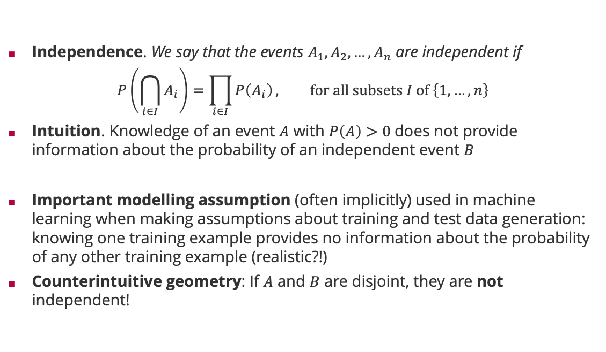


Probability Theory: Independence
Independence. We say that the events $A_{1},A_{2},…,A_{n}$ are independent if
$$P\left(\bigcap_{i∈I}{A_{i}}\right)=\prod_{i∈I}{P\left(A_{i}\right)}, for all subsets I of \left\{1,…,n\right\}$$
Intuition. Knowledge of an event $A$ with $P\left(A\right)>0$does not provide information about the probability of an independent event $B$
Important modelling assumption (often implicitly) used in machine learning when making assumptions about training and test data generation: knowing one training example provides no information about the probability of any other training example (realistic?!)
Counterintuitive geometry: If $A$ and $B$ are disjoint, they are not independent!
$=P\left(B∩A\right)$
$$P\left(B|A\right)=P(B)$$
$$⇔P\left(B|A\right)⋅P(A)=P\left(B\right)⋅P\left(A\right)$$

Slide 27
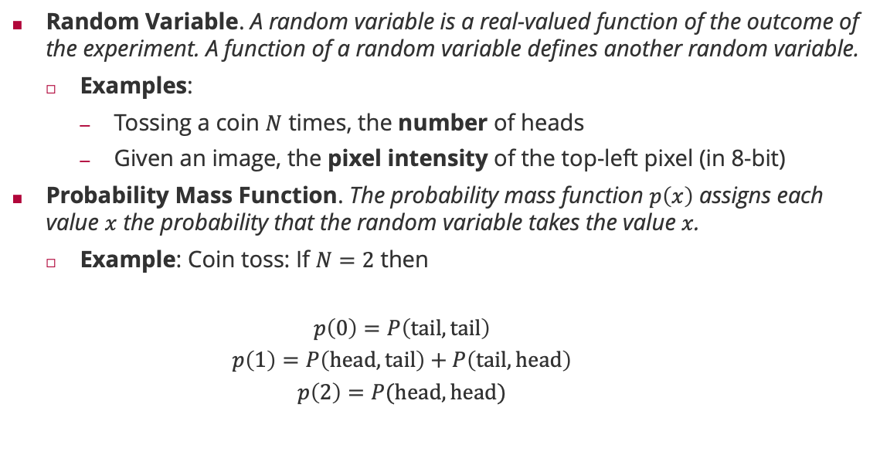
Probability Theory: Random Variable
Random Variable. A random variable is a real-valued function of the outcome of the experiment. A function of a random variable defines another random variable.
Examples:
Tossing a coin $N$ times, the number of heads
Given an image, the pixel intensity of the top-left pixel (in 8-bit)
Probability Mass Function. The probability mass function $p\left(x\right)$ assigns each value $x$ the probability that the random variable takes the value $x$.
Example: Coin toss: If $N=2$ then
$$p\left(0\right)=P\left(tail,tail\right)$$
$$p\left(1\right)=P\left(head,tail\right)+P\left(tail,head\right)$$
$$p\left(2\right)=P(head,head)$$

Slide 28


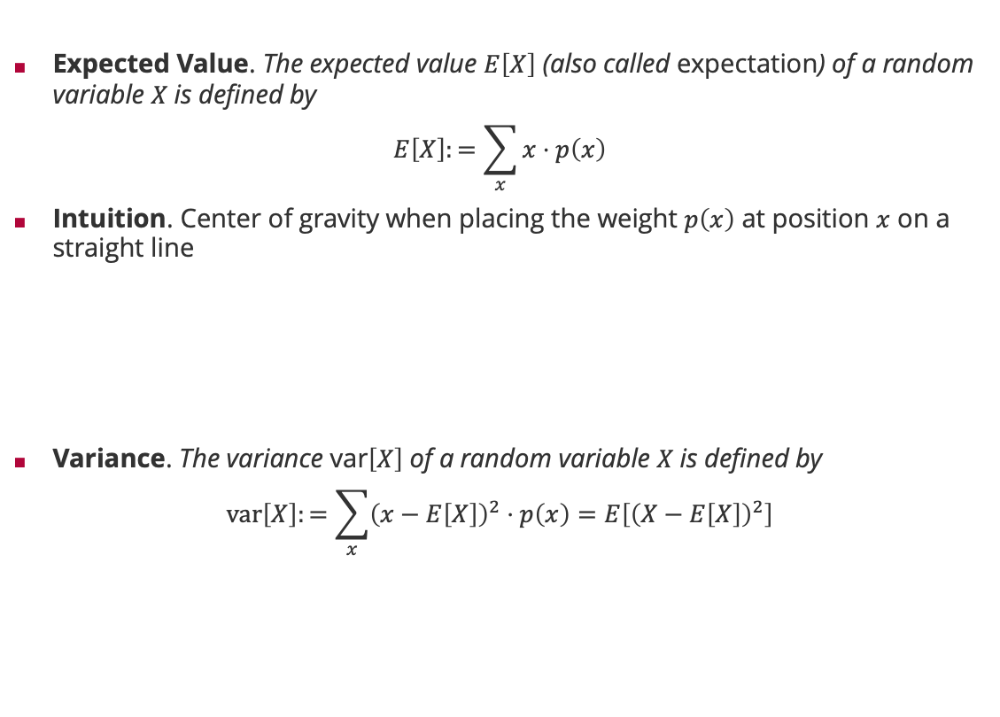



Probability Theory: Expectation and Variance
Expected Value. The expected value $E\left[X\right]$ (also called expectation) of a random variable $X$is defined by
$$E\left[X\right]:=\sum_{x}{x⋅p\left(x\right)}$$
Intuition. Center of gravity when placing the weight $p\left(x\right)$ at position $x$ on a straight line
Variance. The variance var$\left[X\right]$ of a random variable $X$is defined by
$$var\left[X\right]:=\sum_{x}{{\left(x−E\left[X\right]\right)}^{2}⋅p\left(x\right)=E\left[{\left(X−E\left[X\right]\right)}^{2}\right]}$$
$$P\left(1\right)$$
$$P\left(4\right)$$
$$P\left(2\right)$$
$$P\left(3\right)$$
$$E\left[X\right]$$

Slide 29
Overview
History of Machine Learning
Probability in Machine Learning
Probability Theory
Probability Distributions

Slide 30

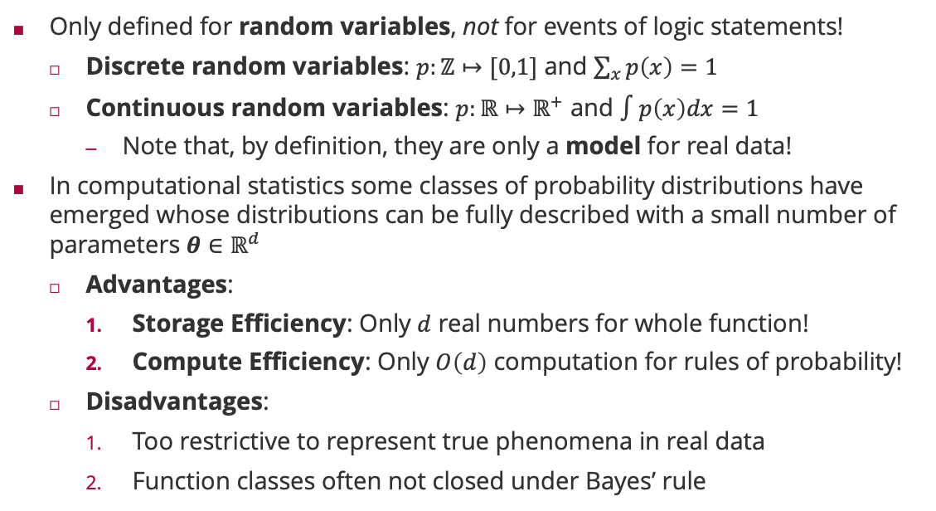
Probability Distributions
Only defined for random variables, not for events of logic statements!
Discrete random variables: $p:ℤ↦[0,1]$ and $\sum_{x}{p\left(x\right)}=1$
Continuous random variables: $p:ℝ↦ℝ^{+}$ and $∫p\left(x\right)dx=1$
Note that, by definition, they are only a model for real data!
In computational statistics some classes of probability distributions have emerged whose distributions can be fully described with a small number of parameters $θ∈ℝ^{d}$
Advantages:
Storage Efficiency: Only $d$ real numbers for whole function!
Compute Efficiency: Only $O\left(d\right)$ computation for rules of probability!
Disadvantages:
Too restrictive to represent true phenomena in real data
Function classes often not closed under Bayes’ rule
Bayes’ Rule for Random Variables
$$p\left(θ|x\right)=\frac{p\left(x|θ\right)⋅p\left(θ\right)}{p\left(x\right)}$$

Slide 31
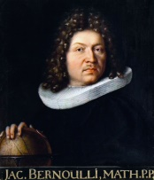
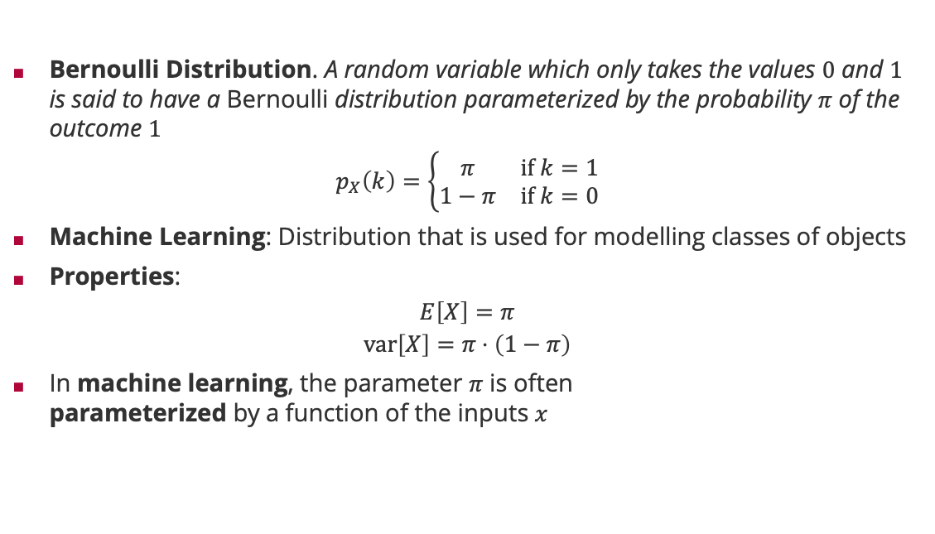
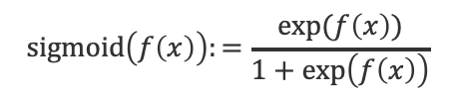
Probability Distributions: Bernoulli
Bernoulli Distribution. A random variable which only takes the values $0$ and $1$ is said to have a Bernoulli distribution parameterized by the probability $π$ of the outcome $1$
$$p_{X}\left(k\right)=\left\{\begin{matrix}π & if k=1 \\ 1−π & if k=0\end{matrix}\right.$$
Machine Learning: Distribution that is used for modelling classes of objects
Properties:
$$E\left[X\right]=π$$
$$var\left[X\right]=π⋅\left(1−π\right)$$
In machine learning, the parameter $π$ is often parameterized by a function of the inputs $x$
Jacob Bernoulli (1655 – 1705)
$$sigmoid\left(f\left(x\right)\right):=\frac{\exp{(f\left(x\right))}}{1+\exp\left(f\left(x\right)\right)}$$

Slide 32
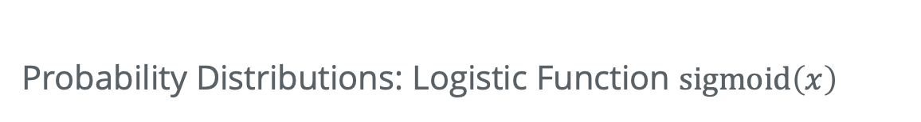
Probability Distributions: Logistic Function $sigmoid\left(x\right)$
$$sigmoid\left(x\right)≔1−sigmoid\left(−x\right)$$

Slide 33
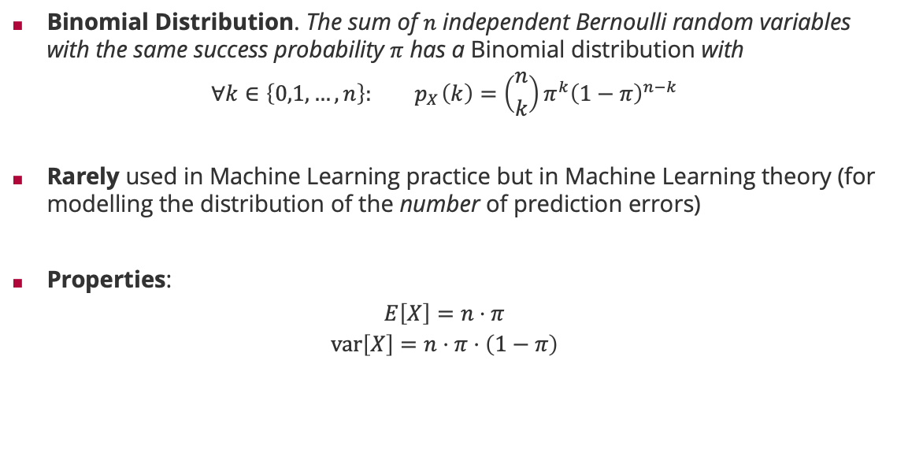
Probability Distributions: Binomial Distribution
Binomial Distribution. The sum of $n$ independent Bernoulli random variables with the same success probability $π$ has a Binomial distribution with
$$∀k∈\left\{0,1,…,n\right\}:{ p}_{X}\left(k\right)=\left({n \atop k}\right)π^{k}{\left(1−π\right)}^{n−k}$$
Rarely used in Machine Learning practice but in Machine Learning theory (for modelling the distribution of the number of prediction errors)
Properties:
$$E\left[X\right]=n⋅π$$
$$var\left[X\right]=n⋅π⋅\left(1−π\right)$$
Jacob Bernoulli (1655 – 1705)

Slide 34
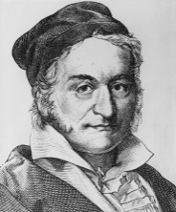
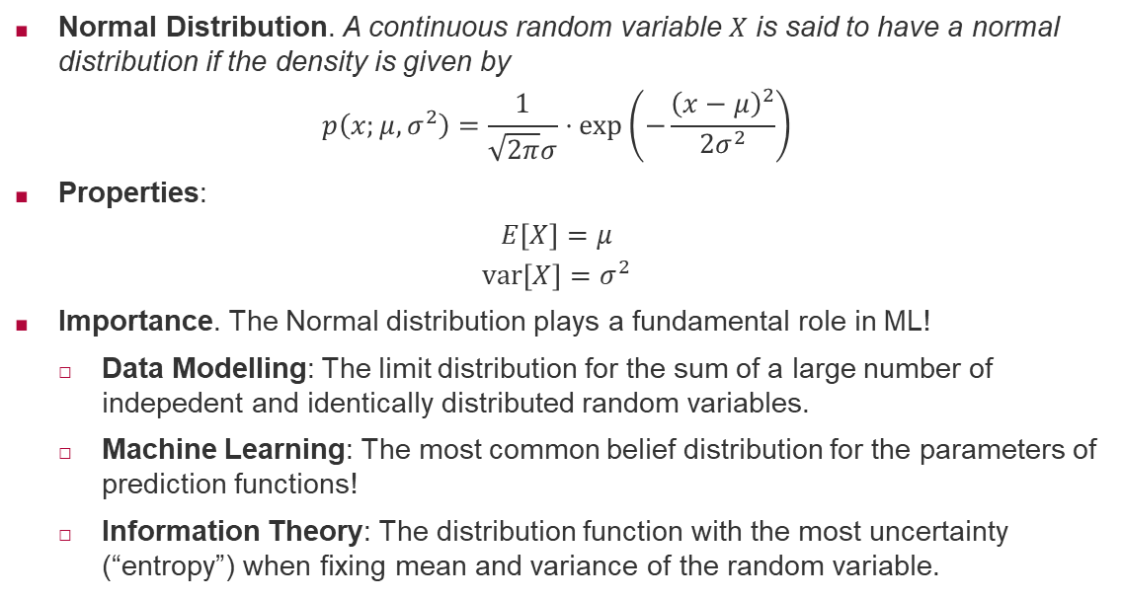
Probability Distributions: Normal
Normal Distribution. A continuous random variable $X$ is said to have a normal distribution if the density is given by
$$p\left(x;μ,σ^{2}\right)=\frac{1}{\sqrt{2π}σ}⋅\exp\left(−\frac{{\left(x−μ\right)}^{2}}{2σ^{2}}\right)$$
Properties:
$$E\left[X\right]=μ$$
$$var\left[X\right]=σ^{2}$$
Importance. The Normal distribution plays a fundamental role in ML!
Data Modelling: The limit distribution for the sum of a large number of indepedent and identically distributed random variables.
Machine Learning: The most common belief distribution for the parameters of prediction functions!
Information Theory: The distribution function with the most uncertainty (“entropy”) when fixing mean and variance of the random variable.
Carl Friedrich Gauss (1777 - 1855)

Slide 35
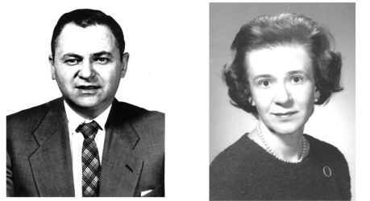
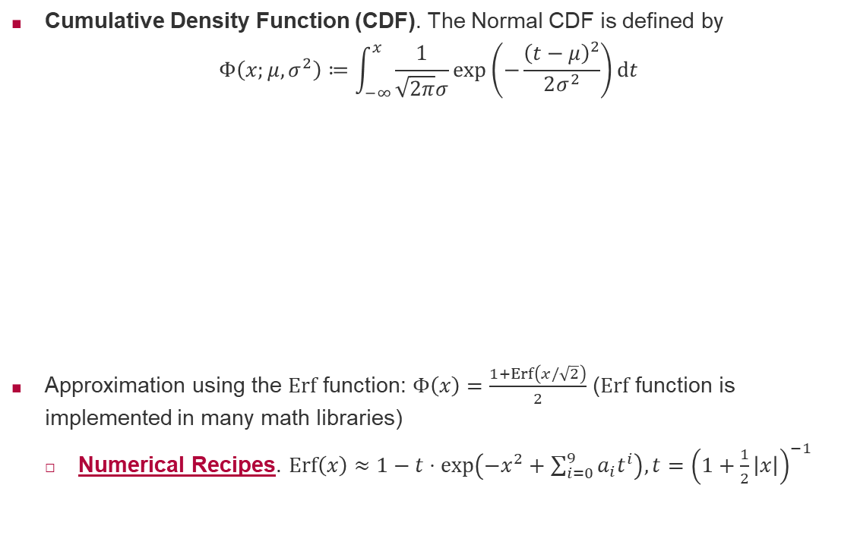
Probability Distribution: Normal (ctd)
Cumulative Density Function (CDF). The Normal CDF is defined by
$$Φ\left(x;μ,σ^{2}\right)≔\int_{−∞}^{x}{\frac{1}{\sqrt{2π}σ}\exp\left(−\frac{{\left(t−μ\right)}^{2}}{2σ^{2}}\right)dt}$$
Approximation using the $Erf$ function: $Φ\left(x\right)=\frac{1+Erf\left(x/\sqrt{2}\right)}{2}$ ($Erf$ function is implemented in many math libraries)
Numerical Recipes. $Erf\left(x\right)≈1−t⋅\exp\left(−x^{2}+\sum_{i=0}^{9}{a_{i}t^{i}}\right), t={\left(1+\frac{1}{2}\left|x\right|\right)}^{−1}$
Milton Abramowitz (1915 – 1958)
Irene Stegun (1919 – 2008)

Slide 36
Summary
History of Machine Learning
Machine learning is a 70-year-old field of research
Key step in artificial intelligence improving on a task based on data
Probability in Machine Learning
Probability is not a physical quantity but a mathematical model of uncertainty
Two different axiomatic justifications of the same math: one for data and one for parameters!
Probability Theory
Two key rules of probability theory: (1) Total probability rule and (2) Bayes’ rule
Independence is a concept of probability; it does not require random variables!
A random variable is a real-valued function of the outcome of the experiment
Probability Distributions
The Bernoulli distribution with a sigmoid link function is key for classification learning
The normal distribution is centrally important in probabilistic machine learning

Slide 37
See you next week!

